Slide 1



SAUCEDEMO AUTOMATION
CAPSTONE PROJECT
PRESENTED BY:
K.DILIP KUMAR
Batch 03,Java Selenium

Slide 2
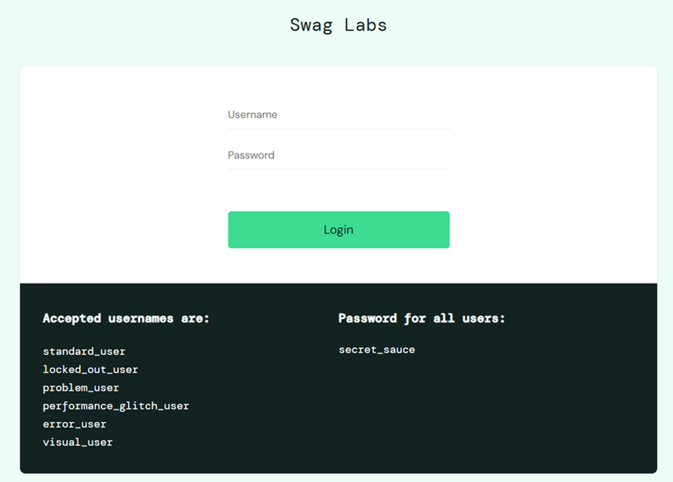


PROJECT DESCRIPTION
For my Capstone Project, I developed a comprehensive automated testing framework for the web application https://www.saucedemo.com. The objective was to automate functional tests, integrate the framework into a CI/CD pipeline, and enable continuous validation of the application's stability.
GITHUB REPO URL:
https://github.com/dilipk2103/Cpastone_pro.git.

Slide 3
TYPES OF TESTING & TOOLS USED
TYPES OF TESTING
•Manual Testing
•Automation Testing with CI/CD integration
TOOLS USED
•Java
•Selenium
•WebDriver
•TestNG
•Cucumber (BDD Framework)
•Maven (Build and Dependency Management)
•GitHub (Version Control)
•Jenkins (CI/CD Automation)
•JIRA (Requirement & Defect Management)
•Extent Reports (HTML Reporting)

Slide 4
Automation Approach
01
02
03
04
Page Object Model (POM)
Cross-Browser Testing
Maven Build System
Java & Selenium

Slide 5


Work Description
Developed automation scripts using Selenium WebDriver + TestNG + Cucumber
Produced detailed HTML reports with screenshots on test failure using Extent Reports
01
04
02
Implemented integration with Jenkins for automated test execution on each code commit
Conducted manual testing using Zphyr Board in JIRA for Sprint backlog management
05
Managed requirements and test cases in JIRA with active tracking of tasks and bugs
03

Slide 6
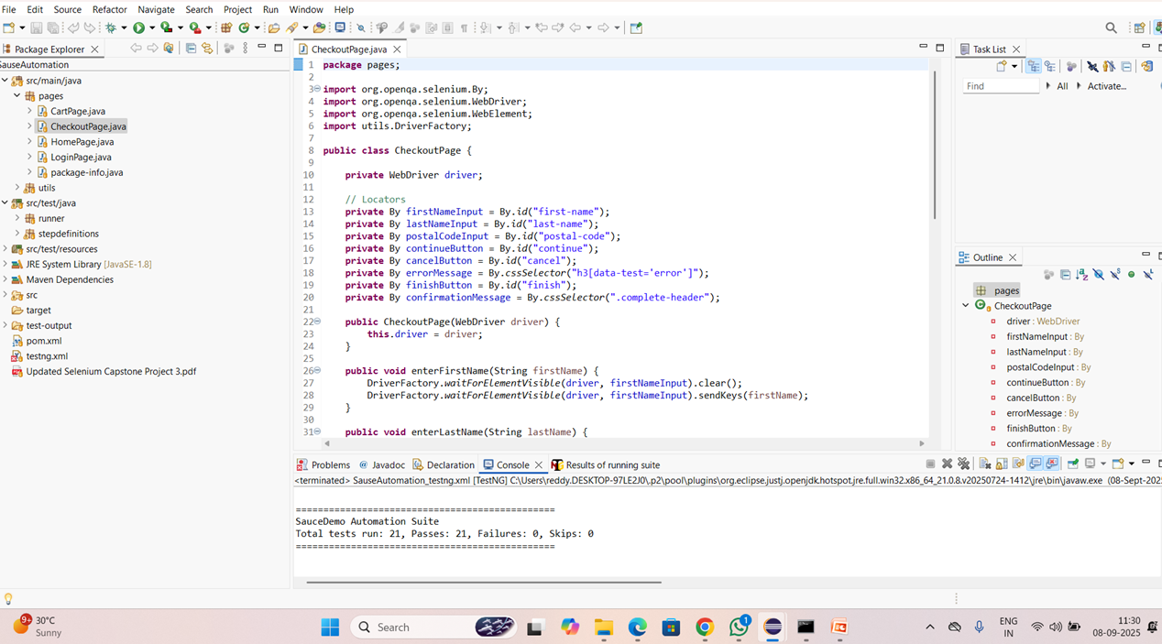
AUTOMATION REPORTS

Slide 7
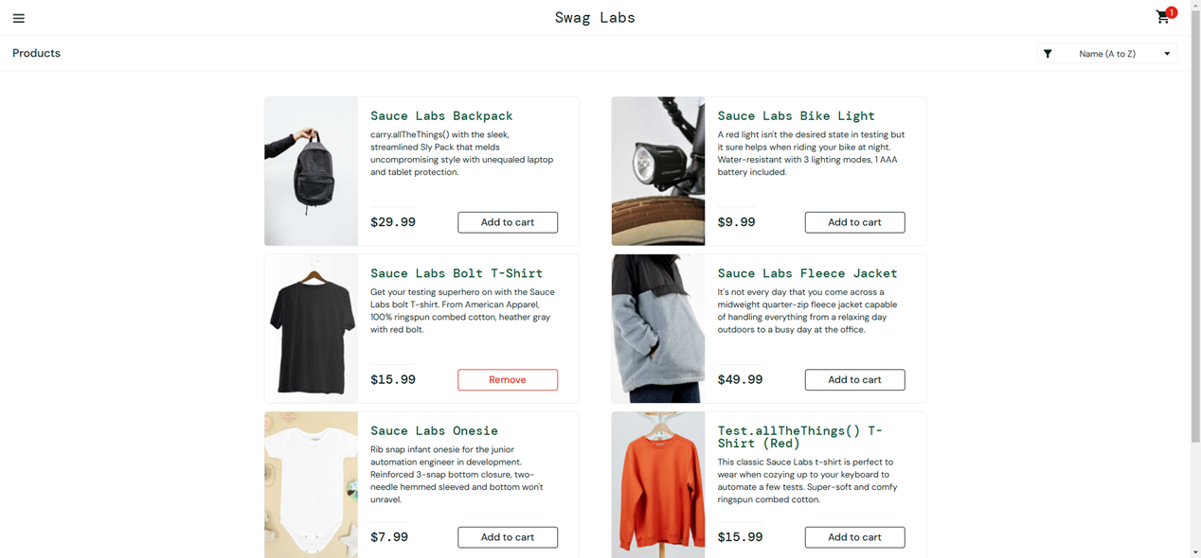
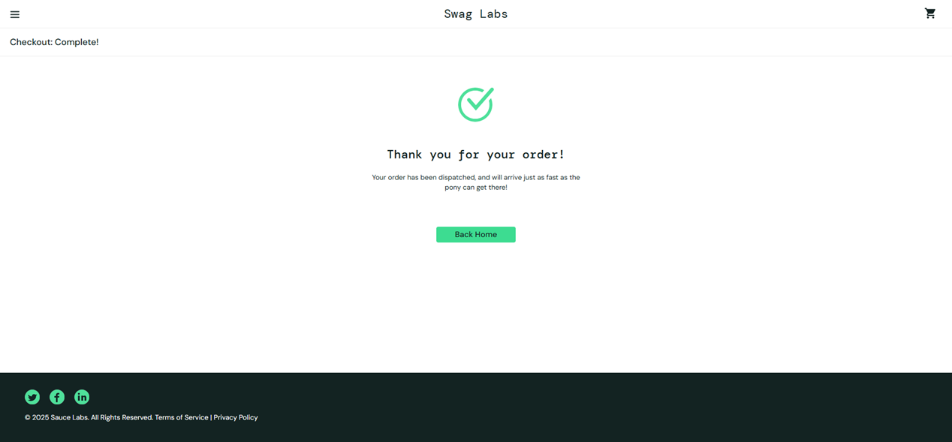
ADD TO CART

Slide 8
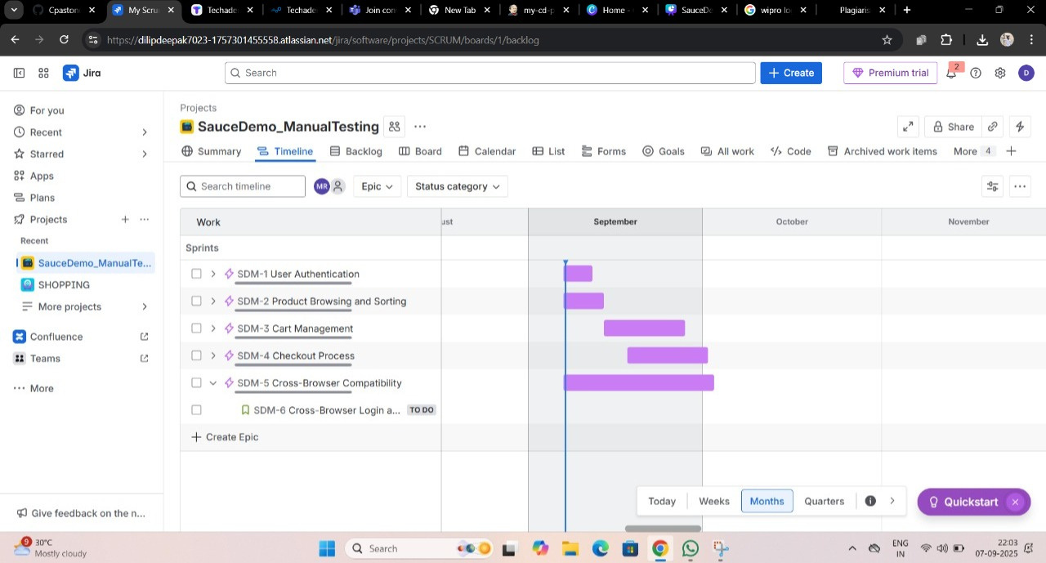
AGILE BOARD

Slide 9
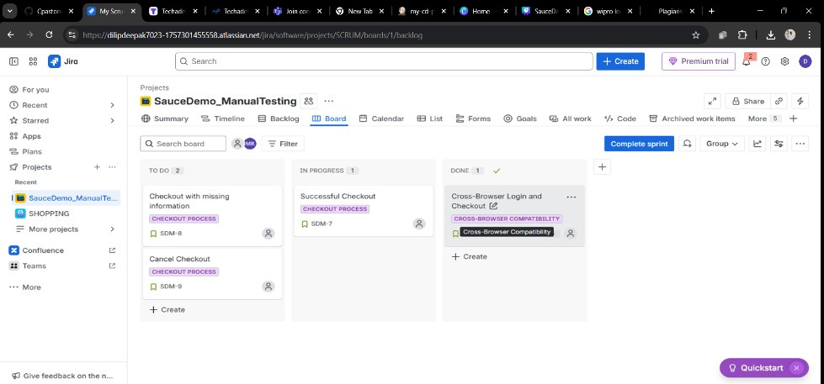
SPRINT CREATION

Slide 10
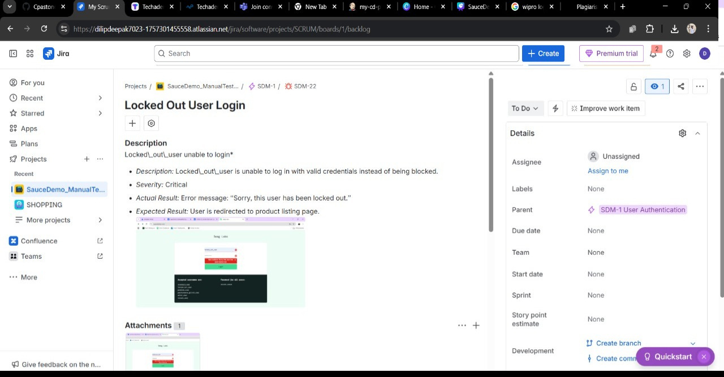
BUG RAISED

Slide 11
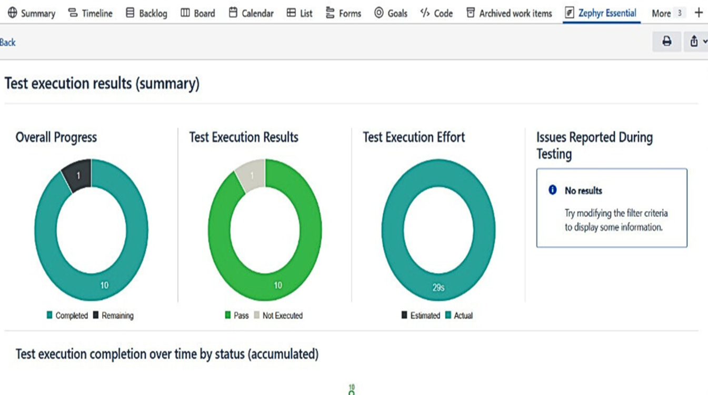
ZEPHYR REPORTS

Slide 12
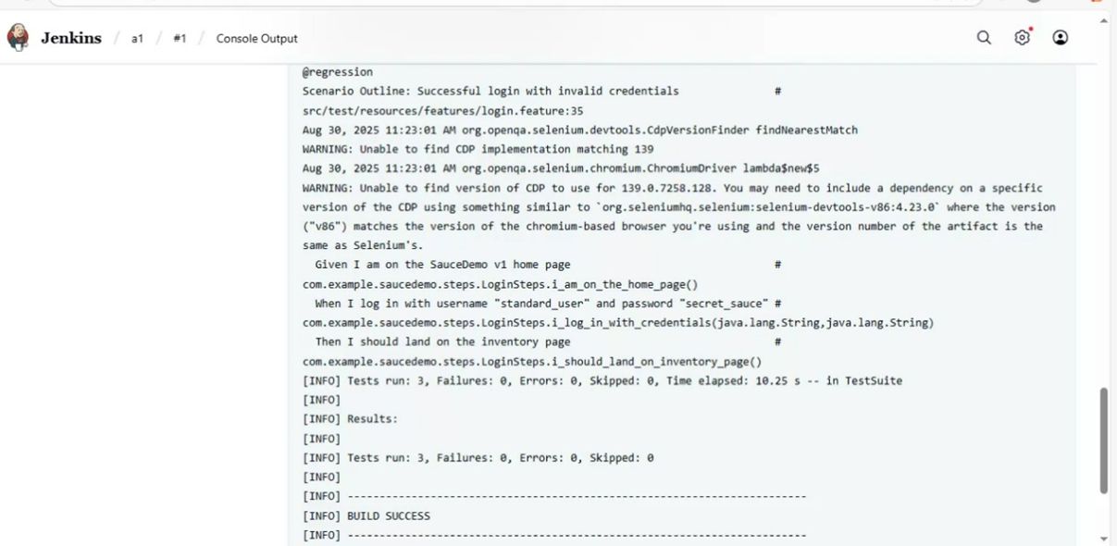
JENKINS FOR CI/CD

Slide 13
Summary
Conducted comprehensive manual testing by designing and executing a variety of test cases, including positive, negative, and edge scenarios to ensure system reliability.
Developed a robust Selenium automation framework utilizing Java, TestNG, and Cucumber to support reusable and scalable test automation.
Performed cross-browser validation on Chrome and Edge to ensure consistent performance and functionality across platforms.
Integrated the test automation framework with GitHub for version control and Jenkins for continuous integration and deployment (CI/CD).
Utilized Jira for efficient management of user stories, test case documentation, and defect tracking.
Generated detailed test reports using Extent Reports, including visual evidence like screenshots for failed test steps.
Combined manual and automated testing strategies to maximize test coverage, reduce regression cycles, and enhance overall software quality.
References:
🔗 GitHub: https://github.com/dilipk2103/Cpastone_pro.git
🌐 Demo Site: https://www.saucedemo.com

